Slide 1
ADVANCING DIABETIC DIAGNOSIS THROUGH CNN ARCHITECTURES AND MACHINE LEARNING PREDICTION

Slide 2
ABSTRACT:
Diabetes mellitus remains a significant global health challenge, necessitating accurate and timely diagnostic methods for effective management. This study explores the application of Convolutional Neural Network (CNN) architectures coupled with machine learning techniques to enhance diabetic diagnosis accuracy. Leveraging a diverse dataset of clinical features, including medical history, biochemical markers, and imaging data, our approach aims to extract intricate patterns and correlations indicative of diabetic conditions. The CNN models are trained on large-scale datasets to discern subtle variations in diagnostic indicators, achieving robust classification performance. Validation against standard clinical practices demonstrates promising results, showcasing the potential of deep learning in augmenting diagnostic precision. This research contributes to the evolution of diabetic healthcare by integrating advanced computational methodologies, paving the way for more personalized and effective treatment strategies.

Slide 3
EXISTING SYSTEM
Leveraging continuous glucose monitoring (CGM) systems, real-time blood glucose (BG) forecasting is essential for proactive interventions, playing a crucial role in enhancing the management of type 1 diabetes (T1D) and type 2 diabetes (T2D). However, developing a model generalized to a population and subsequently embedding it within a microchip of a wearable device presents significant technical challenges. Furthermore, the domain of BG prediction in T2D remains under-explored in the literature. In light of this, we propose a population-specific BG prediction model, leveraging the capabilities of the temporal fusion Transformer (TFT) to adjust predictions based on personal demographic data. Then the trained model is embedded within a system-on-chip, integral to our low-power and low-cost customized wearable device. This device seamlessly communicates with CGM systems through Bluetooth and provides timely BG predictions using edge computing. When evaluated on two publicly available clinical datasets with a total of 124 participants with T1D or T2D, the embedded TFT model consistently demonstrated superior performance, achieving the lowest prediction errors when compared with a range of machine learning baseline methods. Executing the TFT model on our wearable device requires minimal memory and power consumption, enabling continuous decision support for more than 51 days on a single Li-Poly battery charge. These findings demonstrate the significant potential of the proposed TFT model and wearable device in enhancing the quality of life for people with diabetes and effectively addressing real-world challenges.

Slide 4
Drawbacks:
Complexity of Embedding: Embedding the TFT model within a system-on-chip (SoC) of a wearable device introduces technical complexities. Ensuring real-time, reliable operation on a low-power and low-cost device requires rigorous optimization and validation processes, which may be resource-intensive.
Battery Life and Maintenance: While claiming more than 51 days of continuous operation on a single Li-Poly battery charge is impressive, real-world conditions such as varying environmental factors and user behaviors could affect battery life. Ensuring consistent performance over extended periods may require frequent recharging or battery replacements.

Slide 5
PROPOSED SYSTEM
In the proposed system for advancing diabetic diagnosis, the integration of CNN architectures and machine learning prediction within Django presents a framework for accurate and timely diagnosis. Utilizing Convolutional Neural Networks (CNNs), the system can effectively analyze medical imaging data such as retinal scans or X-rays, extracting intricate patterns indicative of diabetic complications. These CNN models are trained to discern subtle features that traditional methods might overlook, thereby enhancing diagnostic precision. Moreover, through Django, the system ensures seamless interaction with healthcare providers and patients, facilitating swift data input, analysis, and result dissemination. By leveraging machine learning predictions, the system not only aids in early detection but also supports personalized treatment strategies based on individual patient data, thereby potentially improving outcomes in diabetic care management.

Slide 6
Advantages:
Enhanced Diagnostic Accuracy: CNNs excel at identifying intricate patterns in medical imaging data, such as retinal scans or X-rays, which can significantly improve the accuracy of detecting diabetic complications compared to traditional methods.
Timely Detection of Diabetic Complications: By leveraging machine learning predictions integrated within Django, the system enables timely detection of diabetic complications. Early identification can lead to prompt intervention and potentially mitigate the progression of the disease.
Efficient Data Handling and Analysis: Django facilitates seamless interaction between healthcare providers and patients, streamlining data input, analysis, and result dissemination. This efficiency not only saves time but also enhances overall workflow in clinical settings.

Slide 7
PREPARING THE DATASET:
This dataset contains train and test image records of features extracted, which were then classified into 5 classes.

Slide 8
LITERATURE SURVEY:
Title : Diabetes Diagnosis Using Machine Learning
Author : Boshra Farajollahi1, Maysam Mehmannavaz, Hafez Mehrjoo, Fateme Moghbeli , Mohammad Javad Sayadi.
Year : 2021
Introduction: Diabetes is a disease associated with high levels of glucose in the blood. Diabetes make many kinds of complications, which also leads to a high rate of repeated admission of patients with diabetes. The aim of this study is to diagnose Diabetes with machine learning techniques. Material and Methods: The datasets of the article contain several medical predictor variables and one target variable, Outcome. Predictor variables includes the number of pregnancies the patient has had, their BMI, insulin level, age. The main objective of the machine learning models is to classify of the diabetes disease. Results: Six classifiers have been also adapted and compared their performance based on accuracy, F1-score, recall, precision and AUC. And Finally, Adaboost has the most accuracy 83%. Conclusion: In this paper a performance comparison of different classifier models for classifying diagnosis is done. The models considered for comparison are logistic regression, Decision Tree, support vector machine (SVM), xgboost, Random Forest and Adaboost. Finally, in the comparison flow, Adaboost, Logistic Regression, SVM and Random Forest, usually has had a high amount; and their amounts has little differences normally.

Slide 9
LITERATURE SURVEY:
Title: Prediction and Detection of Diabetes using Machine Learning.
Author: Olta Llahaa , Amarildo Rista
Year : 2021
Data mining and machine learning have become a vital part of different disease detection and prevention. One of them is diabetes. The purpose of this paper is to evaluate data mining methods and their performances that can be used for analyzing the collected data about the diabetes. We identified the most appropriate data mining methods to analyze the data by comparing them theoretically and practically. Some attributes of this dataset are: Age, Body Mass Index, Insulin, Glucose, etc. Methods are applied on these data to determine their effectiveness in analyzing and preventing diabetes. Evaluations on the data showed that the method with a higher performance is “Decision Tree”. This was achieved by some performance measures, such as the number of instances correctly classified, accuracy, precision, recall and F-measure, that has brought better results compared to other methods. We come to the conclusion that the data mining methods and machine learning contribute to the predictions on the possibility of occurrence of the diabetes.

Slide 10
LITERATURE SURVEY:
Title : Diabetic Diagnosis Using Machine Learning as well as Deep Learning Techniques.
Author: Somendra Tripathi, Hari Om Sharan, C. S. Raghuvanshi
Year : 2023
A growing incidence of Type II diabetes worldwide has prompted the medical industry to explore solutions for enhancing their medical technology. The fields of machine learning and deep learning are now being actively researched for the development of intelligent and efficient methods for detecting diabetes. This research thoroughly examines and explores the effects of the most recent machine learning and deep learning methods on the detection and categorization of diabetes. The accessibility of diabetes statistics is noted to be restricted. The databases consist of measures obtained from laboratory-based tests and invasive procedures. To develop an efficient solution that is both cost-effective and high-performing, it is necessary to do research on anthropometric measures and non-invasive examinations. Multiple studies have shown the potential to develop detection models using anthropometric measures and non-invasive medical indications. This research examined the effects of oversampling strategies and data decrease in dimensionality via the selection of features.

Slide 11
LITERATURE SURVEY:
Title : Diabetes Prediction using Machine Learning Techniques
Author: Mitushi SonI, Dr. Sunita Varma
Year : 2020
Diabetes is an illness caused because of high glucose level in a human body. Diabetes should not be ignored if it is untreated then Diabetes may cause some major issues in a person like: heart related problems, kidney problem, blood pressure, eye damage and it can also affects other organs of human body. Diabetes can be controlled if it is predicted earlier. To achieve this goal this project work we will do early prediction of Diabetes in a human body or a patient for a higher accuracy through applying, Various Machine Learning Techniques. Machine learning techniques Provide better result for prediction by constructing models from datasets collected from patients. In this work we will use Machine Learning Classification and ensemble techniques on a dataset to predict diabetes. Which are K-Nearest Neighbor (KNN), Logistic Regression (LR), Decision Tree (DT), Support Vector Machine (SVM), Gradient Boosting (GB) and Random Forest (RF). The accuracy is different for every model when compared to other models. The Project work gives the accurate or higher accuracy model shows that the model is capable of predicting diabetes effectively. Our Result shows that Random Forest achieved higher accuracy compared to other machine learning techniques.

Slide 12
LITERATURE SURVEY:
Title : Machine Learning for Early Diabetes Detection and Diagnosis
Author: Sofiene Mansouri , Souhaila Boulares , and Souhir Chabchoub
Year : 2023
In this work, a machine learning (ML)-based e-diagnostic system is suggested specifically for the detection of gestational diabetes mellitus (GDM). Reviewing recent GDM data and outlining the intimate connection between GDM and prediabetic conditions, as well as the potential for future declines in insulin resistance and the emergence of overt Type 2 diabetes, were our goals. The present study explores the application of the K-nearest neighbors (KNN) algorithm to project diabetes diagnosis on the widely-used Pima Indians Diabetes database. The KNN algorithm, a non-parametric, instance-based learning method, was employed to classify individuals as either diabetic or non-diabetic, our objectives were to evaluate the algorithm’s ability to make accurate predictions and explore factors influencing its performance. The study commenced with data preprocessing, including handling missing values, feature scaling, and data splitting into training and testing sets. The KNN classifier was trained and tested using these best-fit parameters. The results of this study revealed a model with an accuracy of approximately 0.76 in predicting diabetes diagnosis. This study looked at the various machine-learning approaches for diabetes patient classification, including recall, accuracy, precision, and F1-score. The study discusses the significance of hyperparameter tuning, data preprocessing, and imbalanced data handling in achieving optimal KNN model performance. Lastly, this study shows how the KNN algorithm may be used to project diabetes using the Pima Indians Diabetes Database. The findings suggest that KNN can serve as a viable tool in the early detection of diabetes, paving the way for more extensive applications in healthcare and predictive modelling.

Slide 13
SYSTEM STUDY:
Project Goals:
Load the data
Loading the given dataset
Import required libraries packages
Pre-process the data
Reshape, data augmentations
Define model
Sequential or Functional
Number of layers to be used, Number of nodes to be used in the model, Evaluation metrics
Compile the model
Define loss function, optimizer, weights and bias
Fit the model
Train data, Test data, epoch, Batchsize.

Slide 14
SYSTEM STUDY:
Aim:
The aim of this project is to enhance the accuracy and efficiency of diabetic diagnosis by leveraging Convolutional Neural Network (CNN) architectures and advanced machine learning prediction techniques. By analyzing medical imaging and patient data, the system seeks to identify diabetic conditions at an early stage, improving patient outcomes and reducing the burden on healthcare systems. This innovative approach aims to integrate seamlessly with existing medical practices, providing clinicians with reliable diagnostic tools. Ultimately, the goal is to contribute to better management and treatment of diabetes through cutting-edge AI technology.
Objectives:
Develop a robust Convolutional Neural Network (CNN) model to accurately diagnose diabetes by analyzing medical images and patient data.Integrate machine learning prediction techniques to enhance the precision and reliability of diabetic diagnosis.Leverage advanced algorithms to identify early signs of diabetes, facilitating timely and effective intervention.

Slide 15
SYSTEM STUDY:
Scope:
The project aims to revolutionize diabetic diagnosis by leveraging Convolutional Neural Network (CNN) architectures and machine learning techniques to accurately predict and classify diabetic conditions. By analyzing medical imaging and patient data, the system enhances early detection and treatment planning. The integration with machine learning models allows for continuous improvement in prediction accuracy and diagnostic precision. This innovative approach promises to provide healthcare professionals with powerful tools for more effective diabetes management and patient care.

Slide 16
OUTLINE OF THE PROJECT
Data collection (Splitting Training set & Test) set)
Pre Processing (Sequential)
Building classification Model
Detection(Advancing Diabetic Diagnosis)

Slide 17
Functional requirements:
The software requirements specification is a technical specification of requirements for the software product. It is the first step in the requirements analysis process. It lists requirements of a particular software system. The following details to follow the special libraries like tensorflow, keras, matplotlib.

Slide 18
Non-Functional Requirements:
Process of functional steps,
Problem define
Preparing data
Evaluating algorithm
Improving results
Prediction the result

Slide 19
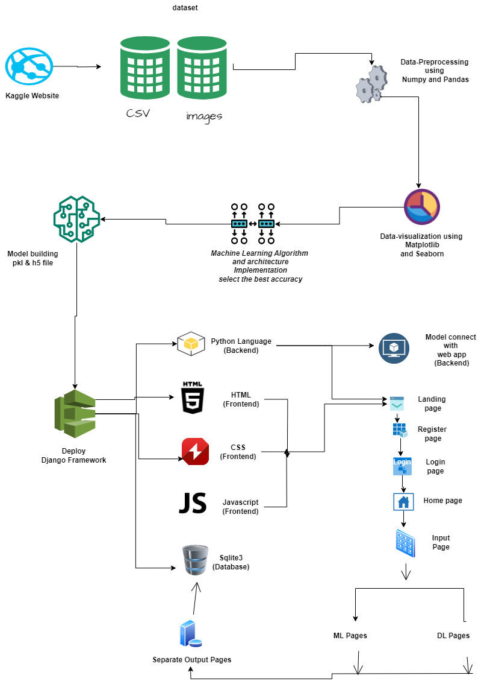
System Architecture:

Slide 20
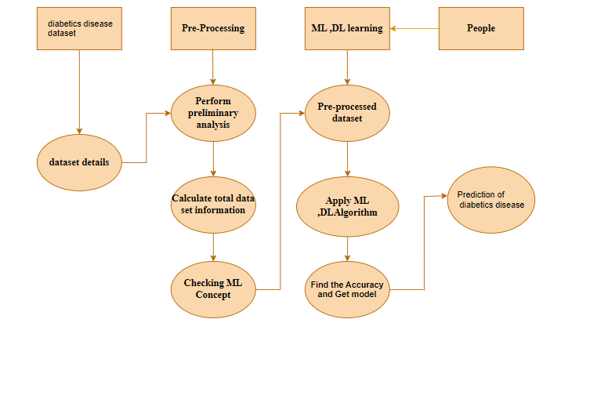
ACTIVITY DIAGRAM:

Slide 21
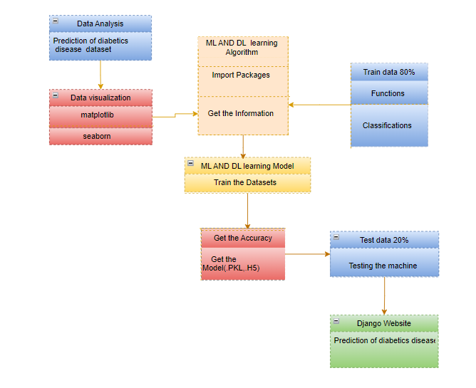
CLASS DIAGRAM:

Slide 22
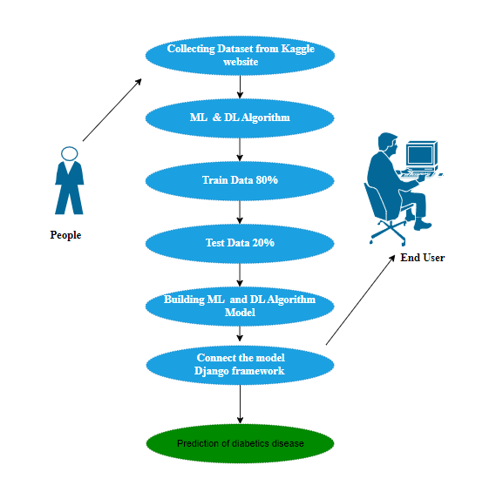
DESIGN ARCHITECTURE:

Slide 23
Project Requirements:
Framework: Keras
1. Software Requirements:
Operating System : Windows
Tool : Anaconda with Jupyter Notebook
Language : Python
2. Hardware requirements:
Processor : minimum i3 and above
Hard disk : minimum 300 GB
RAM : minimum 4 GB

Slide 24
METHODOLOGY:
Preprocessing and Training the model (CNN): The dataset is preprocessed such as Image reshaping, resizing and conversion to an array form. Similar processing is also done on the test image. A dataset consisting of about 5 different diagnosis of diabetes is obtained, out of which any image can be used as a test image for the software. The train dataset is used to train the model (CNN) so that it can identify the test image and the disease it has CNN has different layers that are Dense, Dropout, Activation, Flatten, Convolution2D, and MaxPooling2D. After the model is trained successfully, the software can identify the Automobile parts Classification image contained in the dataset. After successful training and preprocessing, comparison of the test image and trained model takes place to predict the diabetes

Slide 25
LIST OF MODULES:
Data Pre-processing
Data Analysis of Visualization
GRADIENT BOOSTING
Manual Net
LeNet
Deploy

Slide 26
MODULE DESCRIPTION:
Data Pre-processing
Validation techniques in machine learning are used to get the error rate of the Machine Learning (ML) model, which can be considered as close to the true error rate of the dataset. If the data volume is large enough to be representative of the population, you may not need the validation techniques. However, in real-world scenarios, to work with samples of data that may not be a true representative of the population of given dataset. To finding the missing value, duplicate value and description of data type whether it is float variable or integer. The sample of data used to provide an unbiased evaluation of a model fit on the training dataset while tuning model hyper parameters.

Slide 27
Exploration data analysis of visualization
Data visualization is an important skill in applied statistics and machine learning. Statistics does indeed focus on quantitative descriptions and estimations of data. Data visualization provides an important suite of tools for gaining a qualitative understanding. This can be helpful when exploring and getting to know a dataset and can help with identifying patterns, corrupt data, outliers, and much more. With a little domain knowledge, data visualizations can be used to express and demonstrate key relationships in plots and charts that are more visceral and stakeholders than measures of association or significance. Data visualization and exploratory data analysis are whole fields themselves and it will recommend a deeper dive into some the books mentioned at the end.

Slide 28
GRADIENT BOOSTING:
Gradient Boosting is another powerful ensemble learning technique used for both classification and regression tasks. It builds a series of weak learners (typically decision trees) sequentially, with each tree trying to correct the errors of the combined ensemble so far. One of the most popular implementations of Gradient Boosting is the Gradient Boosting Machine (GBM) or its variants like XGBoost, LightGBM, and CatBoost.
Here's an explanation of how the Gradient Boosting algorithm works:
Building Weak Learners:
The algorithm starts by fitting a simple model (weak learner) to the dataset. For regression tasks, this could be a decision tree with just a few levels, and for classification tasks, it could be a shallow decision tree with two classes.

Slide 29
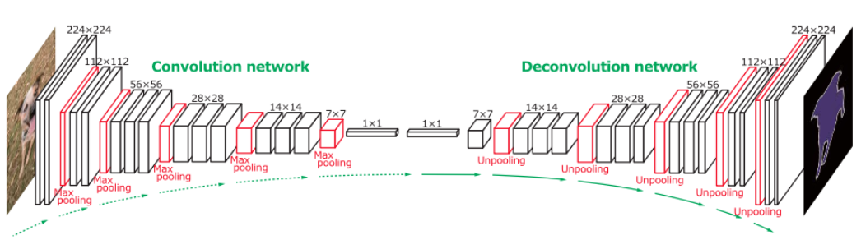
MANUAL ARCHITECTURE:
Manual Architecture is a novel convolutional neural network designed to address specific challenges in machine learning and computer vision tasks. Leveraging a carefully crafted structure, ManuLAL aims to optimize both model performance and computational efficiency.

Slide 30
LENET:
The LeNet architecture is a pioneering convolutional neural network (CNN) architecture developed by Yann LeCun and his colleagues in the early 1990s. It played a crucial role in the advancement of deep learning and was specifically designed for handwritten digit recognition tasks, such as recognizing digits in checks and postal addresses. LeNet laid the foundation for modern CNNs and their applications in image recognition and computer vision tasks.
The LeNet architecture consists of the following layers:
Input Layer: This layer accepts the input image, which is typically a grayscale image of a handwritten digit. The input images are usually of size 32x32 pixels.
Convolutional Layers: LeNet uses two convolutional layers to extract features from the input images. Each convolutional layer applies convolutional filters (also called kernels) to the input image, capturing different patterns and features. These filters slide over the image to create feature maps.

Slide 31
Module 4:Deploy
Deploying the model in Django Framework and predicting output
In this module the trained deep learning model is converted into hierarchical data format file (.h5 file) which is then deployed in our django framework for providing better user interface and predicting the output whether the given image is human feelings.

Slide 32

SCREEN SHOT

Slide 33
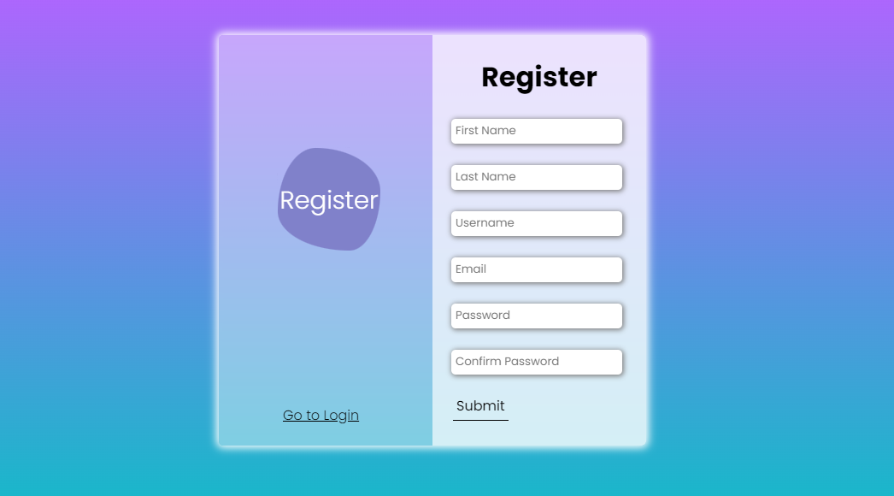
SCREEN SHOT

Slide 34

SCREEN SHOT

Slide 35
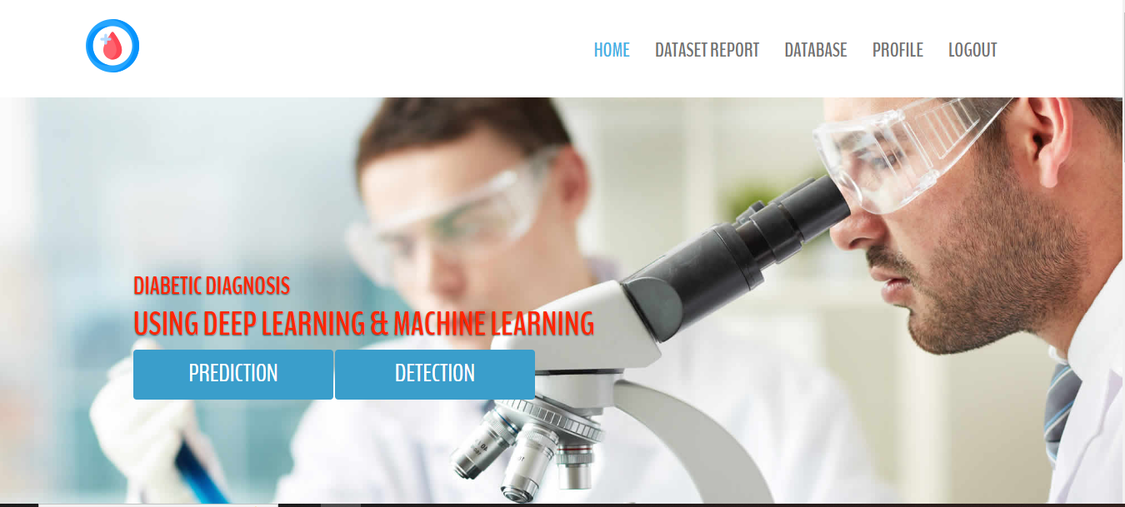
SCREEN SHOT

Slide 36
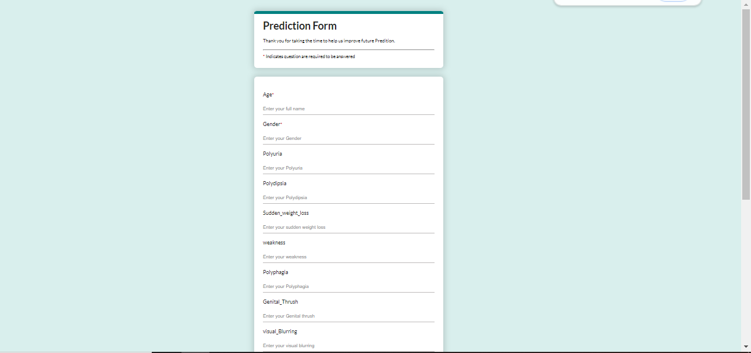
SCREEN SHOT

Slide 37
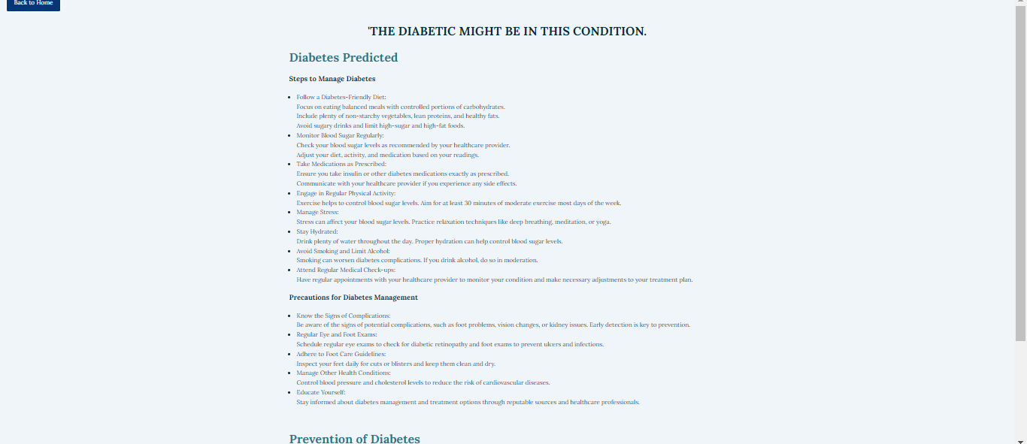
SCREEN SHOT

Slide 38
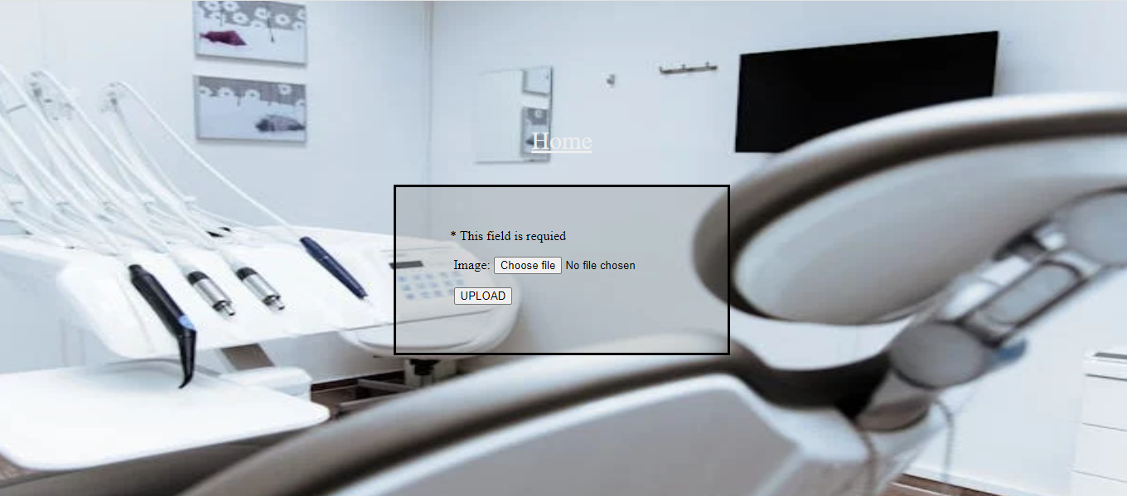
SCREEN SHOT

Slide 39
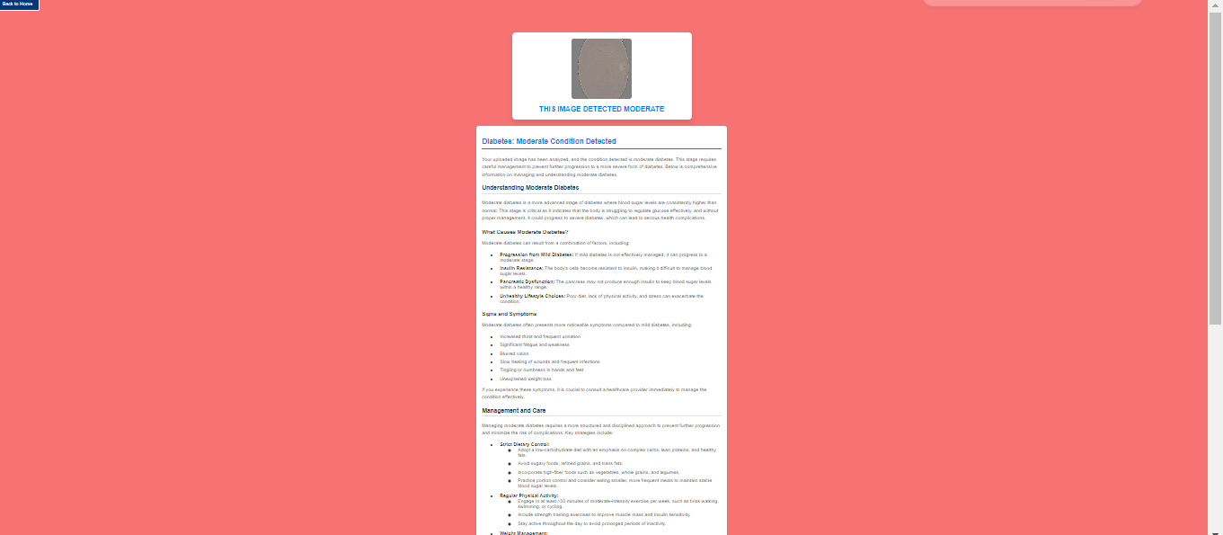
SCREEN SHOT

Slide 40
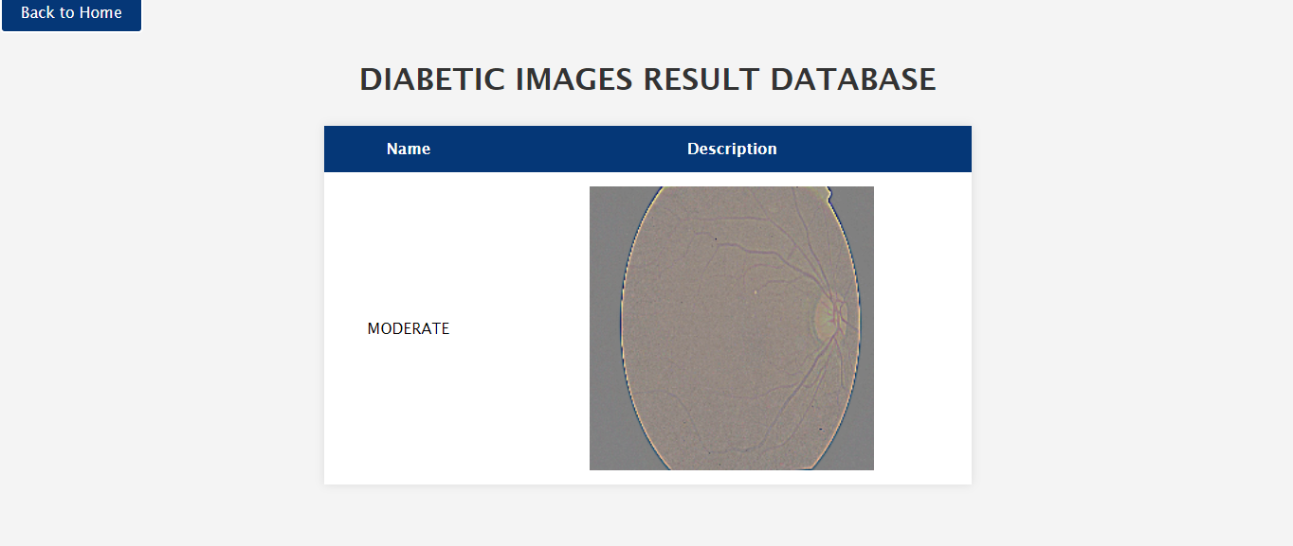
SCREEN SHOT

Slide 41
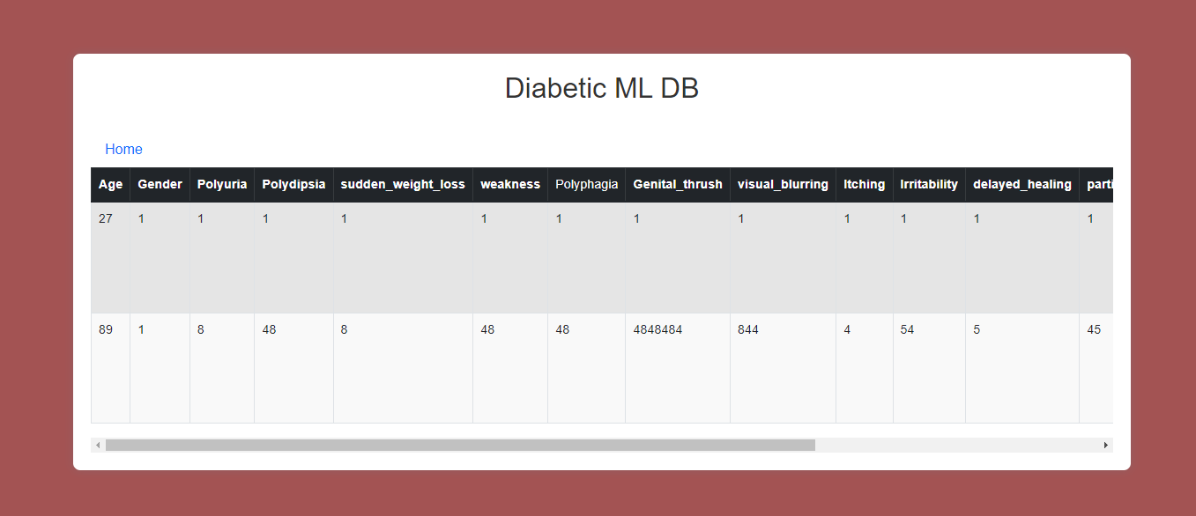
SCREEN SHOT

Slide 42
Conclusion:
This project successfully demonstrates the potential of CNN architectures and machine learning in advancing the diagnosis of diabetes. By developing a deep learning model that can accurately analyze medical data, the project contributes to improving early detection and diagnosis. The integration of this model into clinical practice can enhance decision-making, reduce diagnostic errors, and ultimately improve patient outcomes. The results indicate that deep learning, specifically CNNs, can be a valuable tool in the fight against diabetes, offering a more precise and efficient approach to diagnosis.

Slide 43
Future Work:
We can deploy the model in any cloud-based system.
We can connect this model to the hardware.

